Slide 1


Shield
Insurance

Slide 2

Company Overview
Shield Insurance Company Provides reliable and comprehensive insurance Plans for individuals and businesses, ensuring protection from various risks. Known for commitment to customer care and security. Shield stands out in the market for its focus on coverage reliability, helping customers feel safe and secure.

Slide 3
Objective
Highlight key metrics such as the total number of customers, overall revenue, daily income, customer growth, and percentage changes month over month.
Examine customer segmentation based on age groups, locations, and sales methods to uncover patterns in revenue and customer behavior.
Display trends in customer and revenue growth with an option to switch between graphical views and apply filters for key dimensions like sales mode, age group, city, and month.
Provide an in-depth breakdown of sales mode trends, customer distribution, and revenue proportions by age group, city, and sales method.
Investigate the behavior of different age groups concerning sales mode preferences, policy choices, and anticipated settlements to gain deeper business insights.

Slide 4
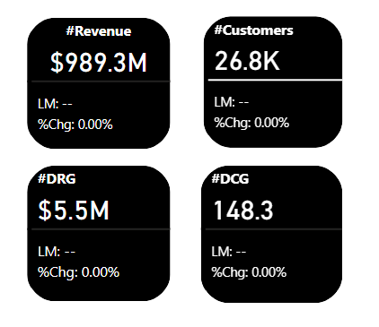
Key Metrics Overview
Total Revenue - 989.3M
Total Customer - 26.8K
Daily Revenue Growth - 5.5M
Daily Customer Growth - 148.3

Slide 5
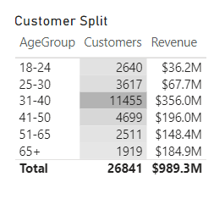
Revenue & Customer Distribution By Age Group
The 31–40 age group leads in revenue, bringing in 356M from 11,455 customers.
The 41–50 age group comes next, contributing 196M, reflecting strong participation from 4,699 customers.
Although it has fewer customers, the 65+ age group stands out by generating 184.9M, highlighting its value as a premium segment.

Slide 6
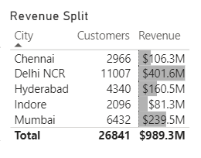
City-wise Revenue & Customer Segmentation
Delhi NCR leads in revenue generation, contributing ₹401.6 million from 11,007 customers, establishing itself as the most lucrative region.
Mumbai comes next, bringing in ₹239.5 million from 6,432 customers, showcasing robust market presence in urban areas.
Chennai and Hyderabad also play a key role, with revenues of ₹106.3 million and ₹160.5 million respectively, highlighting the diverse geographic contributions to overall revenue.

Slide 7
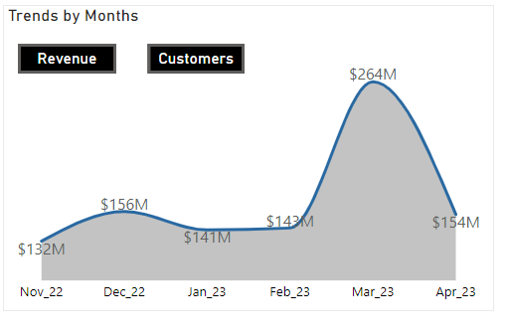
Revenue Trends by Month
Monthly Revenue: Revenue showed noticeable fluctuations, reaching a high of 264M in March 2023 before dropping to 143M in April 2023. January's revenue of 141M highlights the volatility during the year's early months.
Trend Insights: A sharp rise in revenue occurred in March, possibly driven by seasonal factors, followed by a significant decrease in April. The decline from 264M to 143M suggests the impact of external market conditions or operational changes affecting revenue consistency.

Slide 8
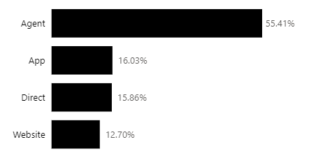
Sales Mode Distribution
The majority of Shield Insurance's sales come through agents, accounting for 55.41%. Other sales channels include the mobile app (16.03%), direct sales (15.86%), and the website (12.70%), indicating that offline methods, such as agents and direct sales, continue to play a crucial role in generating revenue.

Slide 9
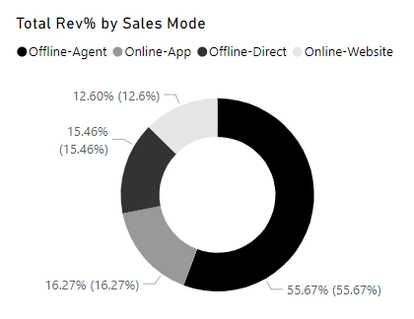
Revenue by Sales Mode
Agents play a crucial role in generating revenue, reflecting the distribution of customers. The offline agent segment accounts for the largest share at 55.67%, followed by various other online and offline channels.

Slide 10
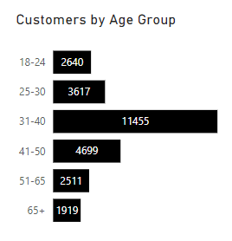
Customer Distribution by Age Group
The age group of 31-40 has the largest customer base at 11,455, indicating it might be a key demographic for the company to focus on.
The 41-50 and 25-30 age groups follow, with 4,699 and 3,617 customers, respectively.
The 18-24 and 65+ age groups have comparatively fewer customers, suggesting that these younger and older populations may be less involved or have distinct insurance requirements.

Slide 11
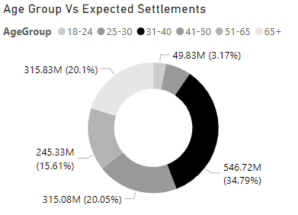
Expected Settlement by Age Group
The 31-40 age group accounts for the highest proportion of anticipated settlements at 34.79%, potentially indicating increased risk or a higher frequency of claims within this demographic.
The 25-30 and 41-50 age groups also exhibit significant settlement expectations, representing 20.05% and 20.1%, respectively, which could guide more informed strategies for risk evaluation and policy management.

Slide 12
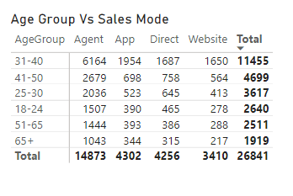
Age Group Vs Sales Mode
Sales conducted through agents are prevalent across all age groups, especially among individuals aged 31-40, highlighting the importance of personal interaction in driving sales.
Online platforms, such as apps and websites, are more commonly used by younger age groups, particularly those aged 18-24 and 25-30, indicating a strong inclination toward digital engagement among younger customers.

Slide 13
Key Insights
Most Profitable Month: March 2023, with total revenue of 263.8M and 7081 new customers.
Key Demographics: The primary customer age group was 31-40 years.
Top Selling City: Delhi NCR.
Successful Sales Mode: Offline-Agent mode.
Rapidly Ascending Sales Mode: Online App & Website.
Top Policy: POL4321HL with a base premium of Rs.5000.

Slide 14

Thank You!

